Slide 1


Slide 2
Welcome, to yet another tale under the Python Series…..

Slide 3
We present to you, the sequel to Exception Handling 1
Exception Handling The Final Chapter

Slide 4
Presented By
Group 10
Tanisha
Riya Nain
Anushka Gupta
Asheesh Kumar
Aditya Chaurasiya
Kamaltosh Jha

Slide 5

Mysteries yet to be revealed
Introduction to Exception Handling
Types of Exceptions - Built In Exceptions
User Defined Exceptions
Mini program
Try ,Except keyword
Finally and Else keyword
The Final Showdown - A Program Depicting the above.

Slide 6

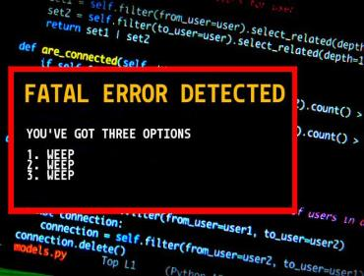
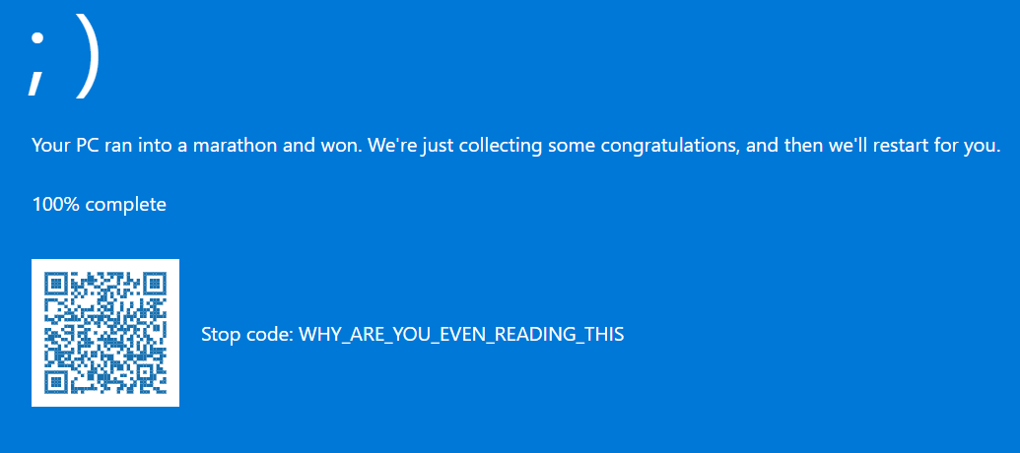
Introduction to Exception Handling

Slide 7
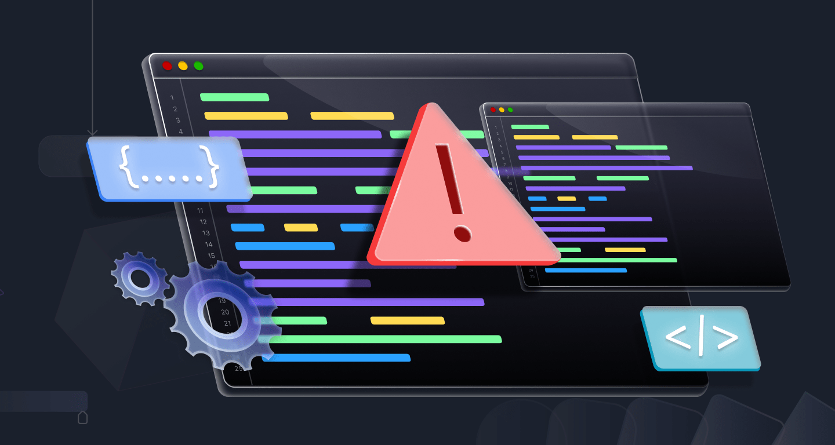

Slide 8


Slide 9

INTRODUCTION TO EXCEPTION HANDLING

Slide 10
INTRODUCTION TO EXCEPTION HANDLING
An exception is an error which happens at the time of execution of a program.
However, while running a program when an error occurs, Python generates an exception that should be handled to avoid your program to crash.
In Python language, exceptions trigger automatic on errors, or they can be triggered and intercepted by set of code.
Example
Suppose we have to make an online payment using mobile application but we don’t have enough money in our bank account. Now at this time we get an insufficient fund error from the payment application.This can be interpreted as an exception because we get it at run time and it warned us before causing some fault to the underlying system

Slide 11
SITUATIONS THIS CAN BE IMPLEMENTED
Some common examples of such errors are dividing a number by zero, adding two incompatible types, trying to access a non-existent index of a sequence or accessing a file that does not exist.
Exception handling is mechanism through which we can handles the run time error.
Exception Handling is not the ultimate way to handle errors, there are methods to do it with custom ways, later in the slides
There are some keywords involved
try, except, raise, finally and else
Taken further in the slides.
There are types of Exceptions as well. Some are already there in python and also a way by which we can create our own.

Slide 12
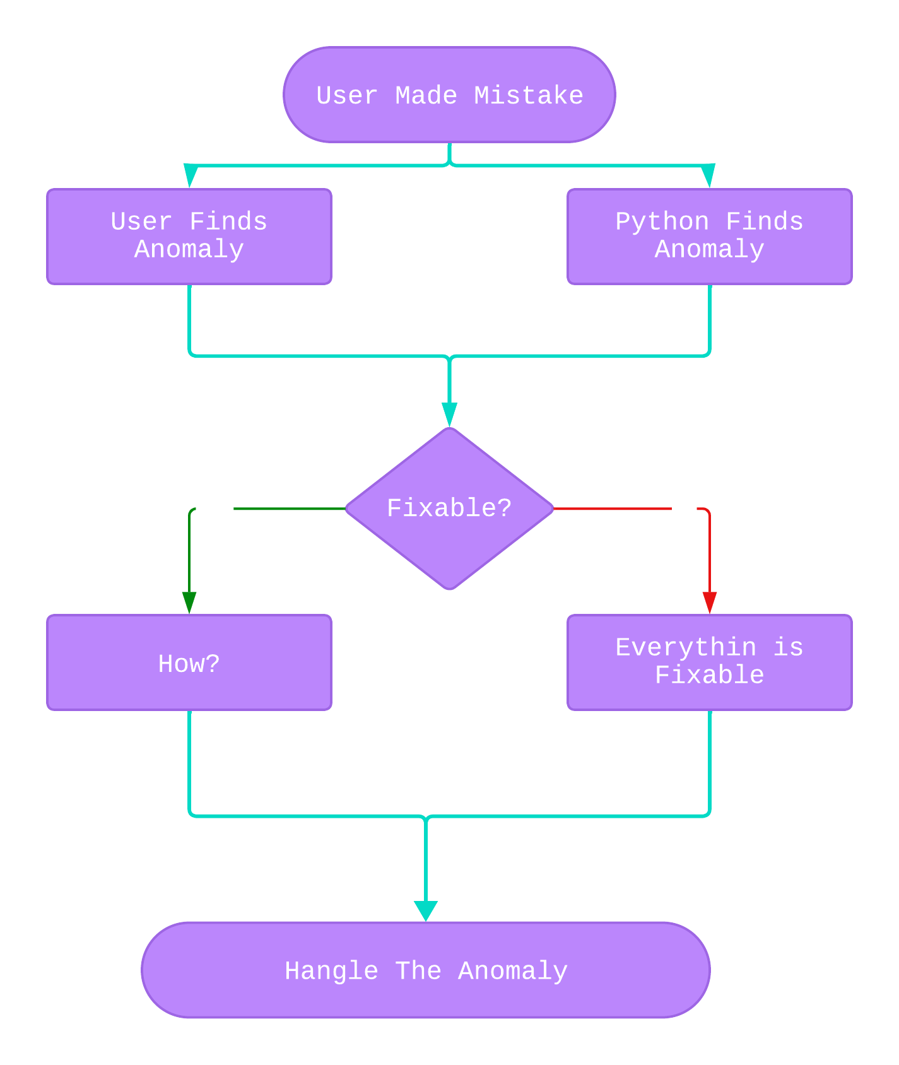
The Underlying Process

Slide 13
TYPES OF EXCEPTIONS

Slide 14
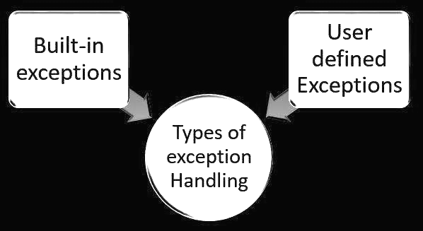
TYPES OF EXCEPTIONS

Slide 15

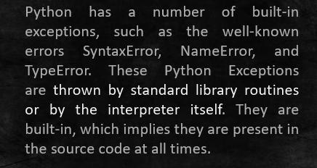
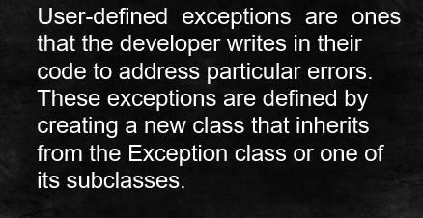

Built-In Exceptions
User Defined Exceptions

Slide 16

Built-in Exceptions

Slide 17
Built-in Exceptions
While writing code in Python, errors can occur due to various reasons, such as invalid input, syntax errors, or unexpected behavior.
To handle such errors, Python provides a set of built-in exceptions. These exceptions are predefined in Python and can be raised by the interpreter or by the user’s code.
When a program encounters a condition which may cause error or a fault during runtime, the Python Interpreter raises some predefined exceptions. These exceptions are part of the Python language and provide a way to handle errors and unexpected situations.
These exceptions help in debugging and handling errors gracefully. They can be caught using try-except blocks to handle specific errors or perform appropriate actions when an exception occurs.

Slide 18
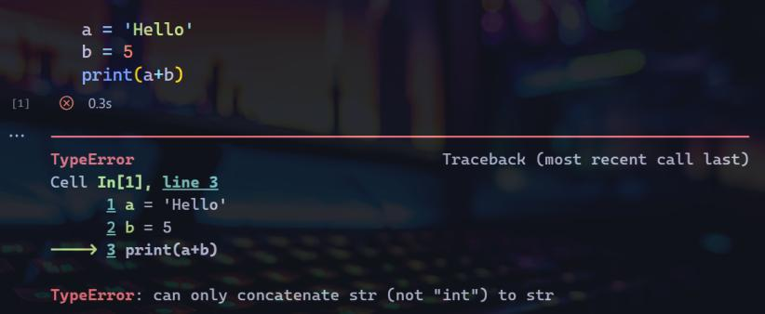
These are as follows……..
TYPE ERROR:
This exception is raised when an operation or function is applied to an object of inappropriate type.
For example, trying to concatenate a string and an integer will result in a TypeError.

Slide 19
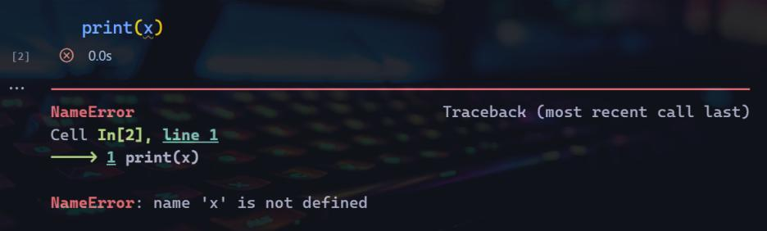
NameError – This exception is raised when a name or variable is not defined. For example, if we try to access a variable that has not been defined, a NameError will be raised.

Slide 20
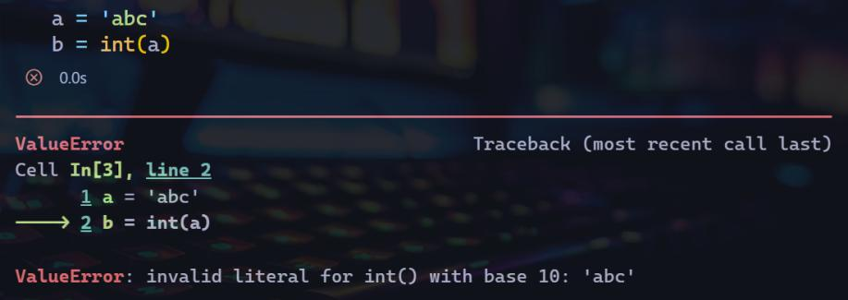
ValueError – When an operation or function is applied to an object with an inappropriate value, this exception is thrown. A ValueError will be raised, for instance, if an attempt is made to convert a string to an integer when the string does not represent an acceptable integer.

Slide 21
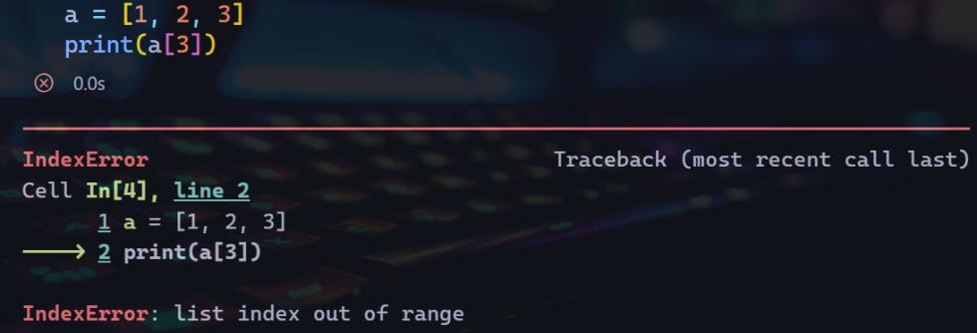
IndexError – When an index is outside of bounds, this exception is thrown. An IndexError will be raised, for instance, if an element in a list is attempted to be accessed using an index that does not exist.

Slide 22
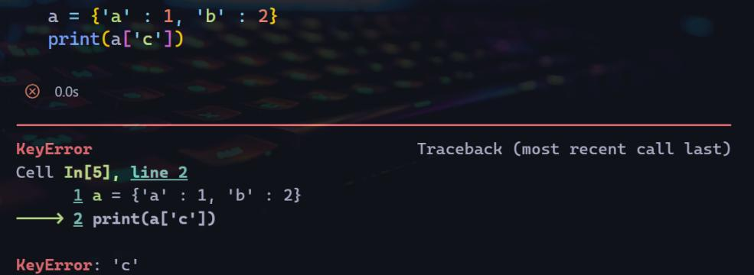
KeyError – This exception is raised when a key is not found in a dictionary. For example, trying to access a value in a dictionary with a key that does not exist will result in a KeyError.

Slide 23
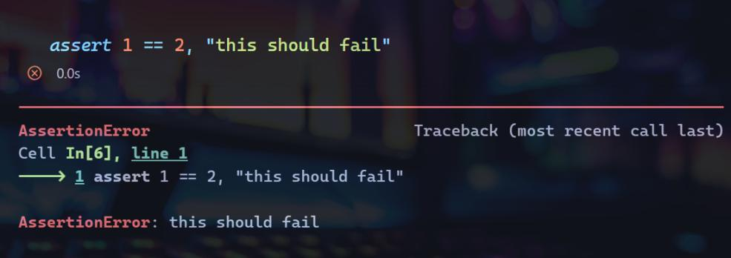
AssertionError – This exception is raised when an assertion fails. Assertions are used to check that certain conditions are met, and if they are not, an AssertionError is raised.

Slide 24
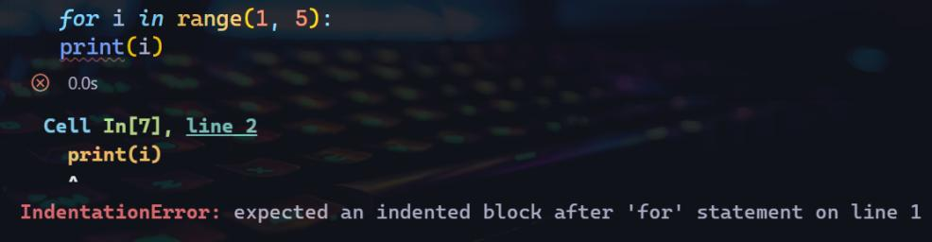
IndentationError – Raised when indentation is incorrect:

Slide 25
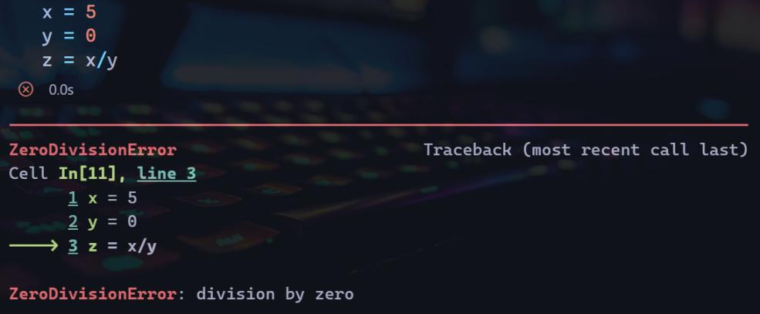
ZeroDivisionError: When the second operator in a division is zero, an error is raised.

Slide 26
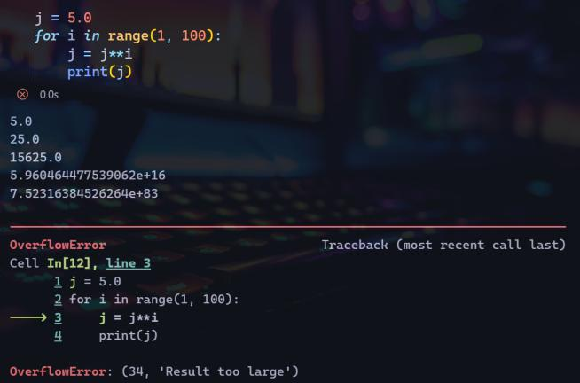
Overflow Error: This error is raised when an arithmetic operation exceeds the limits to be represented

Slide 27
There are more…..

Slide 28
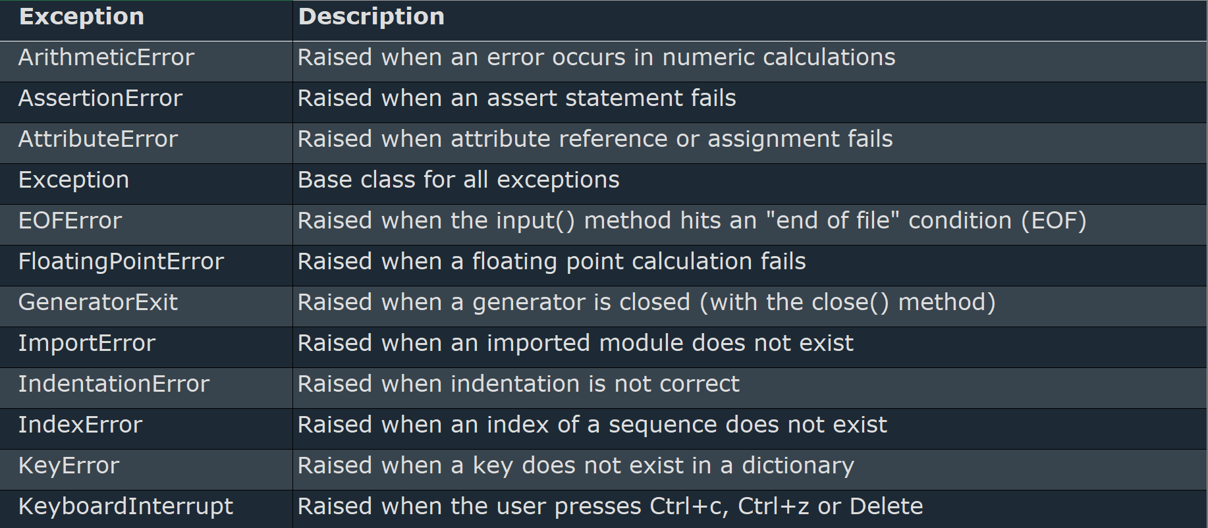
Built-In Exceptions in Python

Slide 29
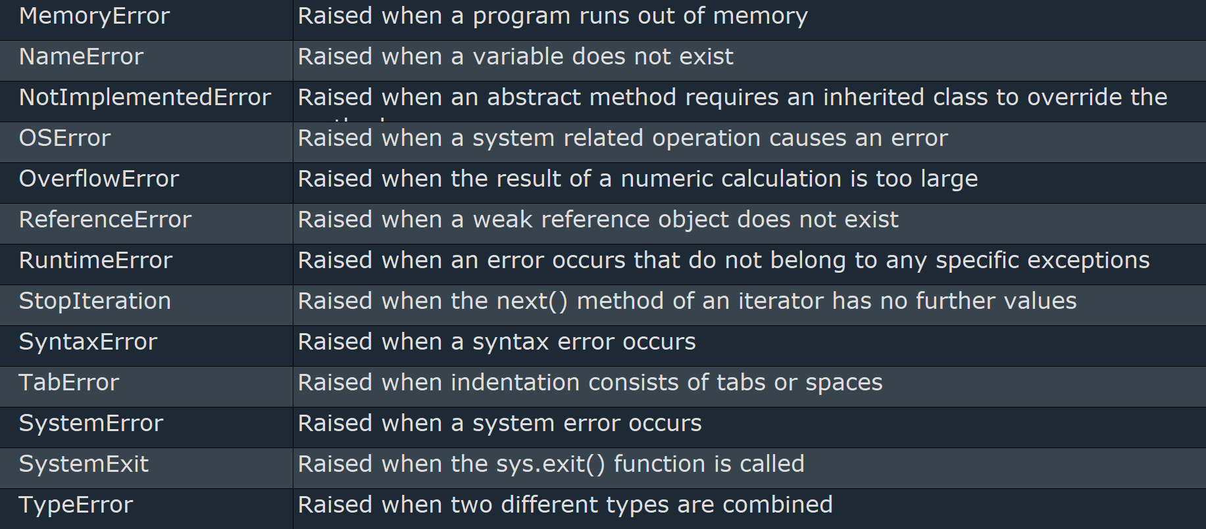
Built-In Exceptions in Python (Contd.)

Slide 30
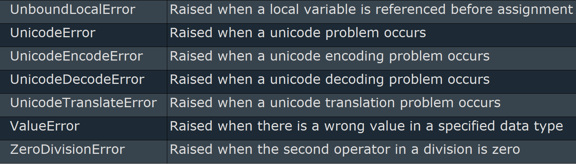
Built-In Exceptions in Python (Contd.)

Slide 31
User Defined Exceptions

Slide 32
i) USER DEFINED EXCEPTIONS
What are User-defined exceptions?
User-defined exceptions are exceptions made by a user to address particular scenarios in their code. They are derived from the Exception class or one of its subclasses.

Slide 33
Need for User-defined exceptions?
Unique exceptions that are suited to the particular requirements of a project.
Custom exceptions give programmers the ability to deliver thorough error messages that can aid in the runtime diagnosis of problems and facilitate their resolution.
They offer a way to arrange and encapsulate error handling logic, custom exceptions can improve the readability and maintainability of code.

Slide 34
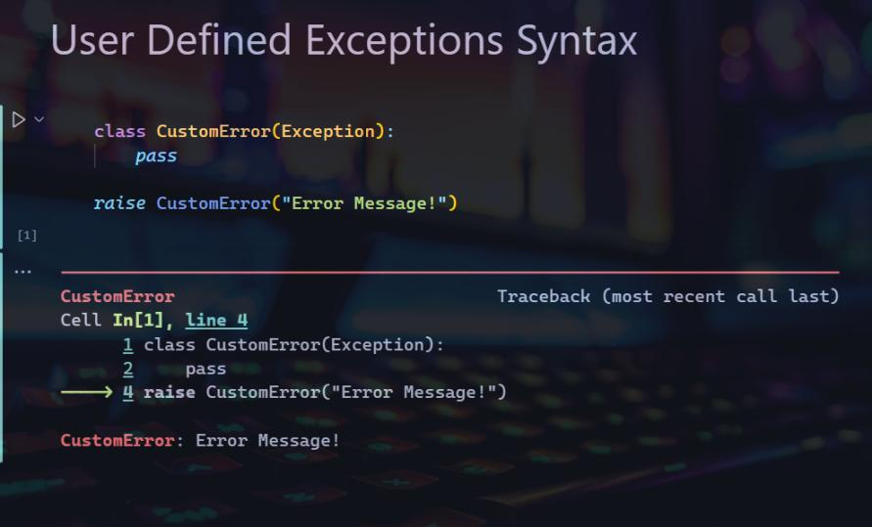

Slide 35
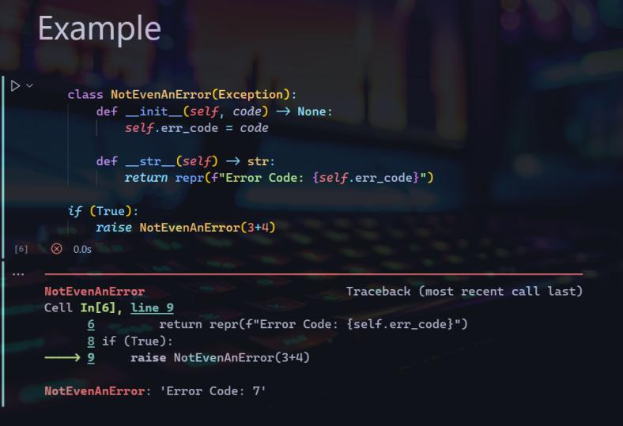

Slide 36

Exception Handling Keywords are not the ultimate way to handle error !

Slide 37
Managing Edge Cases without Exception Handling
Example : Calculator Program

Slide 38
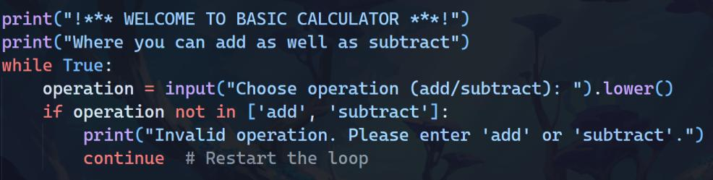
Welcome screen and operation choice

Slide 39
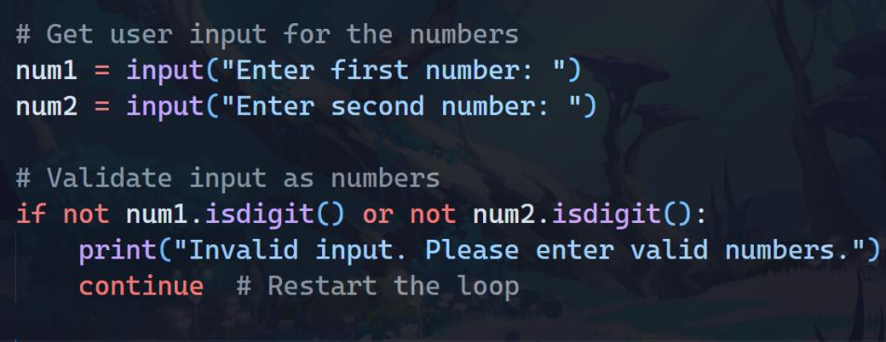
Getting and Validating Input operands

Slide 40
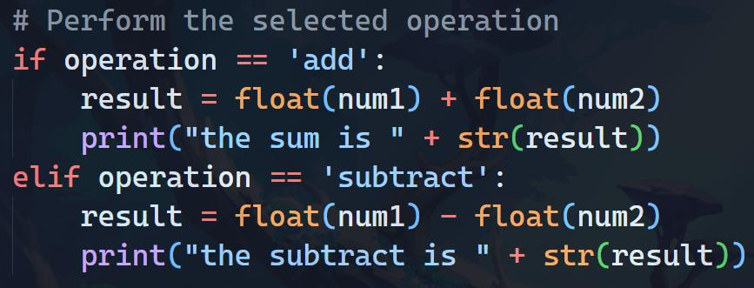
Performing operations based on choice

Slide 41
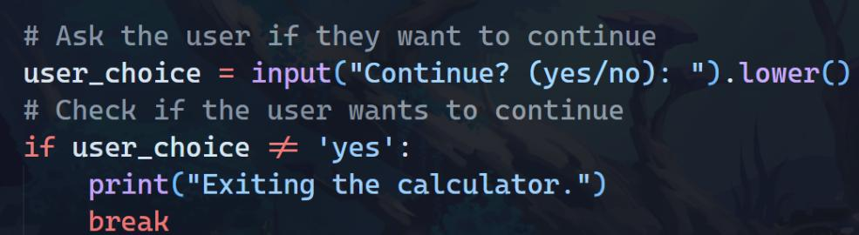
Continue or Exit based on input

Slide 42
OUTPUT - 1
!*** WELCOME TO BASIC CALCULATOR ***!
Where you can add as well as subtract
Choose operation (add/subtract): add
Enter first number: 12
Enter second number: 13
the sum is 25.0
Continue? (yes/no): yes

Slide 43
OUTPUT - 2
Choose operation (add/subtract): subtract
Enter first number: 100
Enter second number: 50
the subtract is 50.0
Continue? (yes/no): no
Exiting the calculator.

Slide 44
Keywords related to Exception Handling

Slide 45
TRY -EXCEPT
The try block lets you test a block of code for errors.
The except block lets you handle the error.

Slide 46
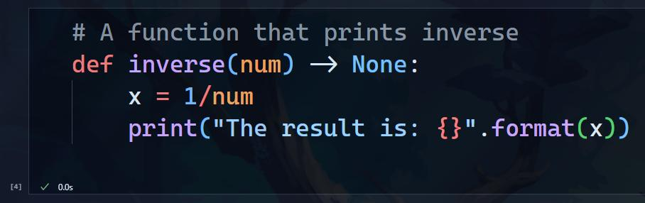
CODE 1 OF TRY - EXCEPT

Slide 47
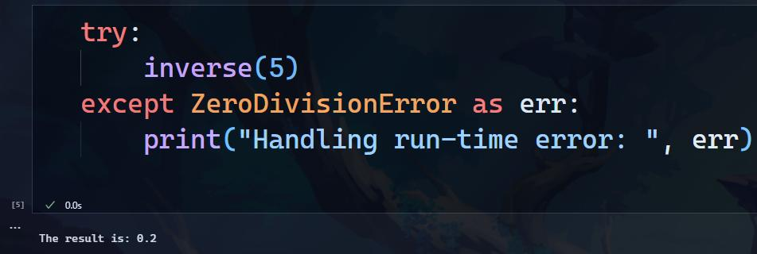
NO EXCEPTION OCCURS

Slide 48
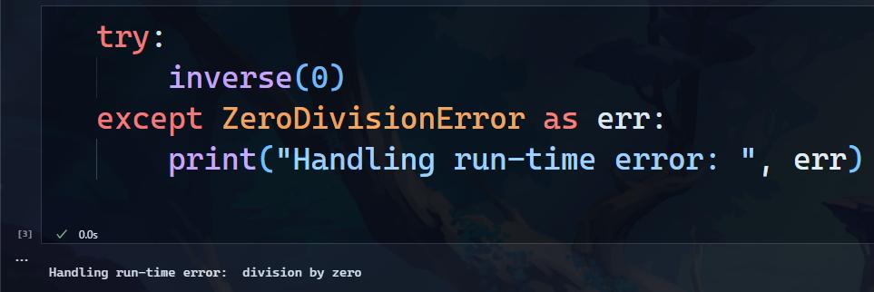
EXCEPTION OCCURS

Slide 49
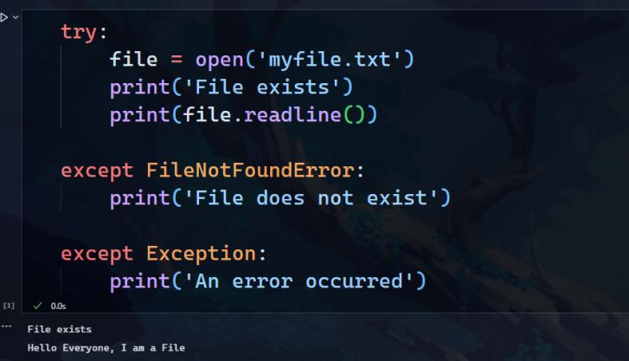
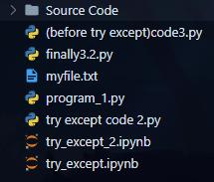
CODE 2 OF TRY - EXCEPT Case I
Folder Contents

Slide 50
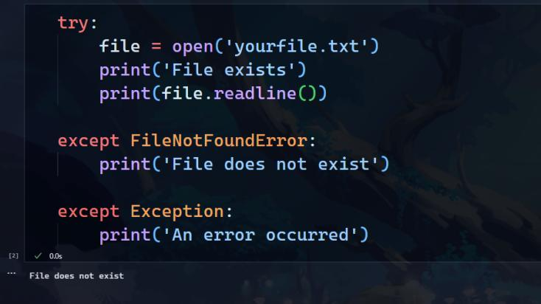
CODE 2 OF TRY - EXCEPT Case II
Folder Contents

Slide 51
Finally
The finally block lets you execute code, regardless of the result of the try- and except blocks.

Slide 52
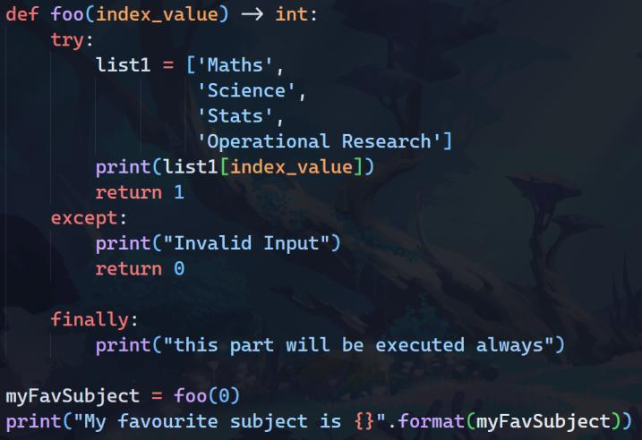
CODE OF Finally

Slide 53

OUTPUT
Maths
this part will be executed always
My favourite subject is 1

Slide 54
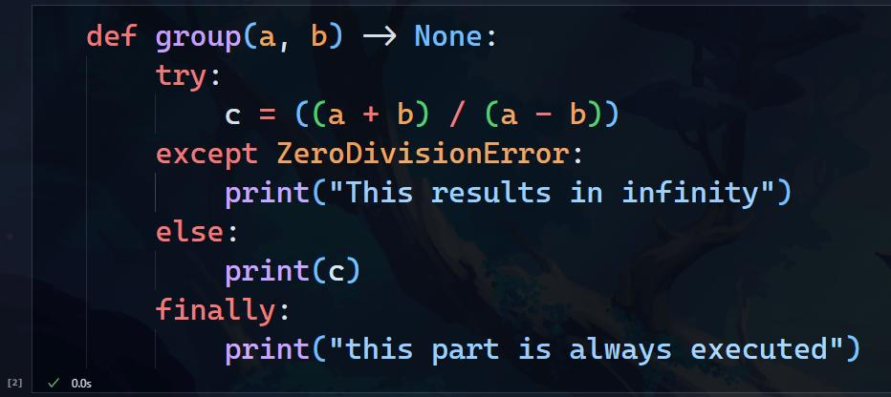
Try with else clause

Slide 55
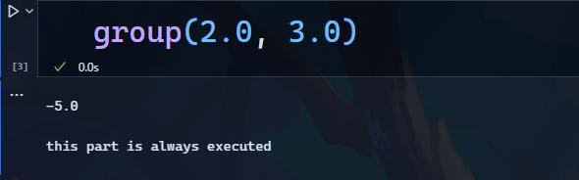
Case I

Slide 56
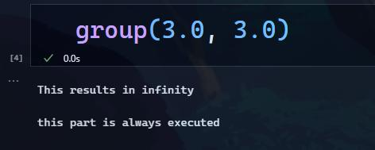
Case II

Slide 57
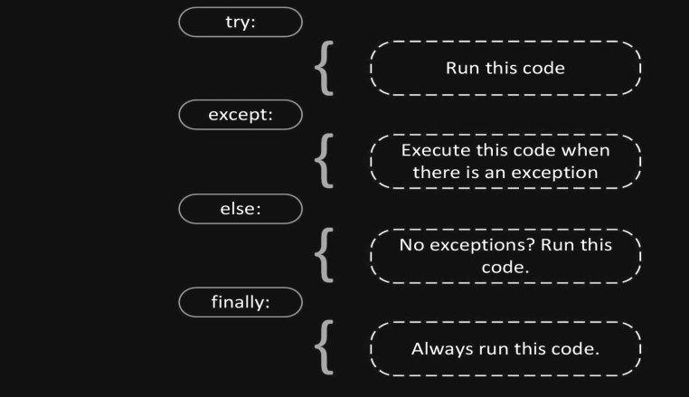
Exception Handling in One Picture

Slide 58


Slide 59
Program to depict the usage of Exception Handling
A simple and short example, for easy and faster explanation

Slide 60
Example Program : Checking Armstrong Number
This is one of the programs we created as practicals 😎
The example presented here depicts a program that simply uses keywords
try , except, raise, else, finally
Here we need to check whether the number entered by the User is an Armstrong number or not.
We did this program without using these keywords, we simply used if-else with warnings where some exceptions could have occurred
Now lets see how we can use the exception handling feature to make it user friendly

Slide 61
A Quick Recap
What are Armstrong Numbers?
Why Named So?
Also Known as
Real Life Applications
Example

Slide 62
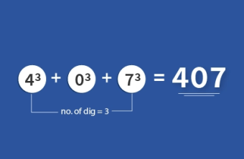
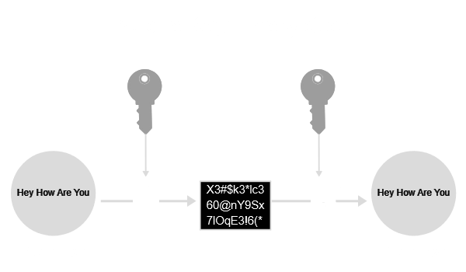



Slide 63
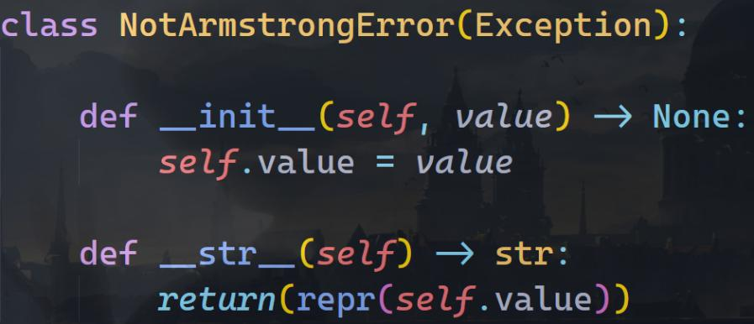
Example 1
Our Own Class

Slide 64
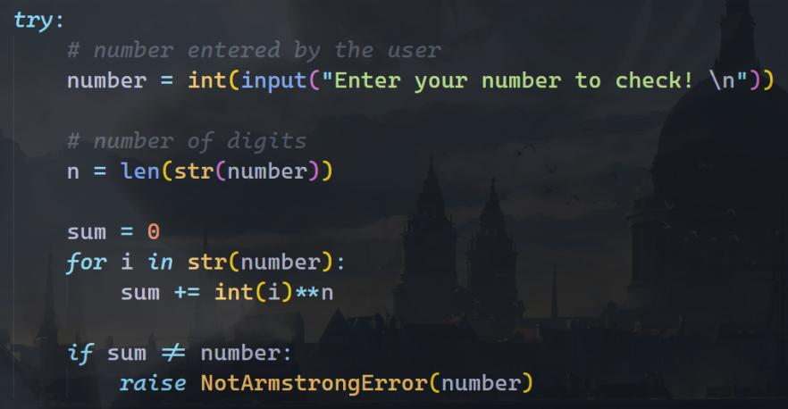
b) try block

Slide 65
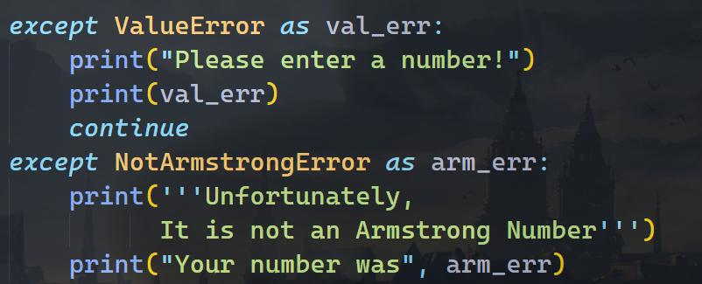
c) except block(s)

Slide 66
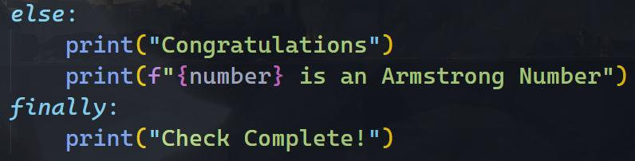
d) else and finally block

Slide 67
Program 1 Output - Case I
Enter your number to check!
370
Congratulations
370 is an Armstrong Number
Check Complete!
Do you want to test another number? Enter 1 for Yes, and 0 for No
1

Slide 68
Program 1 Output - Case II
Enter your number to check!
360
Unfortunately,
It is not an Armstrong Number
Your number was 360
Check Complete!
Do you want to test another number? Enter 1 for Yes, and 0 for No
1

Slide 69
Program 1 Output - Case III
Enter your number to check!
abcd
Please enter a number!
invalid literal for int() with base 10: 'abcd'
Check Complete!
Enter your number to check!
67
Unfortunately,
It is not an Armstrong Number
Your number was 67
Check Complete!
Do you want to test another number? Enter 1 for Yes, and 0 for No
0
Thank you and Good Bye!

Slide 70

The
End

Slide 71


Thank You !
GitHub Repo.
Includes Source Code, Jupyter Notebooks, Images and More..

